Slide 1

How to Automate API Testing
(TDD + BDD) = ATDD

Slide 2
knock,knock .. ☺
Pavan Yadlapalli – Automation Architect
Parallel programming on Super Computers
Telecom Integrations (C, C++, JSP)
Developer, Automation, Cloud Native

Slide 3
Theam
µSvc
TDD & BDD
Testing & Test Automation
Automation & Gates
References & Links
Q&A
Tests & levels of testing
implementation on sample apps
Postman

Slide 4
µ Services
Why? smaller, more focussed "micro" services.
Micro
Independent
Cooperating
12- Factors (http://12factor.net/)
Start with Monolith , Separate them based on demand (http://www.appcontinuum.io/)
Notes:
There has been a shift in service based architectures over the last few years towards smaller, more focussed "micro" services. There are many benefits with this approach such as the ability to independently deploy, scale and maintain each component and parallelize development across multiple teams.

Slide 5
Testing & Test Automation
Why Testing
Production-ready software requires testing before it goes into production
whether the developed software met the specified requirements or not and to identify the defects to ensure that the product is defect free
Why Test Automation
Continuous delivery
Building, testing and deploying an ever-increasing amount of software manually soon becomes impossible
It's obvious that testing all changes manually is time-consuming, repetitive and tedious. Repetitive is boring, boring leads to mistakes

Slide 6
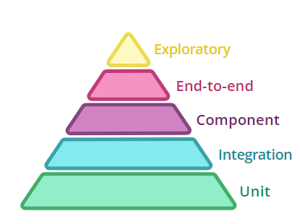
Tests
Present in our Services, we have tried coverage gates at 50%
Sometimes convoluted.
Didn’t ensure that the service will even get up.
So, Whats the correct way?
● Run the whole app’s process.
● App “doesn’t know” it’s not in production.
● Run locally, before a commit.
● High confidence that the app will get up.
● ...require external services and data bases...
https://martinfowler.com/articles/microservice-testing/#conclusion-test-pyramid
Notes:
Write tests with different granularity
The more high-level you get the fewer tests you should have
Write lots of small and fast unit tests. Write some more coarse-grained tests and very few high-level tests that test your application from end to end. solitary unit tests for tests that stub all collaborators and sociable unit tests for tests that allow talking to real collaborators

Slide 7
TDD (Just what we need) but how?
Functional Test
Unit Test
Fail
Refactor
Pass
Pass
Inside
(TDD)
Fail
Outside
(BDD)
Refactor
Notes:
TDD is Test-Driven Development: the idea is that unit tests are written first, then enough code is written to make the tests pass BDD is Behavior-Driven Development: this technique operates at a slightly higher level than TDD while still following the basic principle of writing the test, then coding to pass the test. BDD is usually the lowest level that will use the Given-When-Then pattern to describe the test ATDD - is Acceptance-Test-Driven Development: this and BDD are often, in my experience, used interchangeably, particularly if the acceptance test is expressed in the Given-When-Then pattern

Slide 8
Pros and Challenges of this Approach
encourages better design of production code
increases the testability of the product
quick feedback to developers
Automation
Requirements
Discipline
Tools

Slide 9
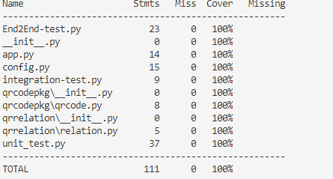
TDD – Just TDD Python..!
Python
Pylint
Bravado (Swagger)
Mountebank
Flask
Unit test
def test_create_qrcode_isnone(self):
with self.assertRaises(TypeError):
self.tmp.createQR()
def test_create_qrcode_scale(self):
self.assertIn(b'PNG', self.tmp.createQR("test",6))
Component test
@patch('qrrelation.relation.relation.relationdf',return_value='5678')
def test_getrelation(self,relationdf_mock):
self.assertIsNotNone(self.tmp.getRelation("tmp"))
Integration Test
def test_something(our_service, db):
db.put(TEST_DB_ENTRY)
response = requests.get(
our_service.url + '/something',
headers={'Authorization': TEST_AUTH_HEADER})
assert response.status_code == 200
import pytest, redis
@pytest.yield_fixture(scope='function')
def db(db_session):
yield db_session
db_session.flushdb()
@pytest.fixture(scope='session')
def db_session(redis_port):
return redis.Redis(port=redis_port, db=0)

Slide 10
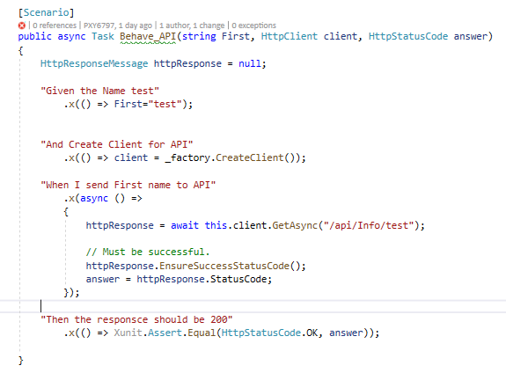
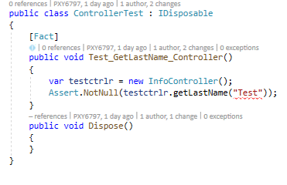
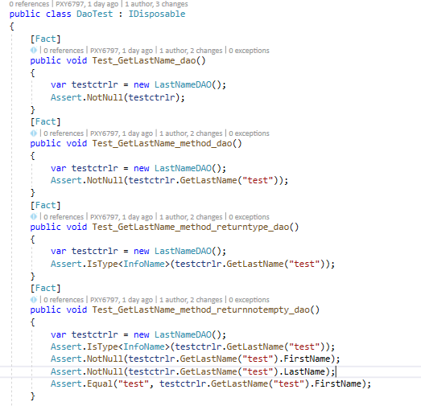
ATDD Example –TDD & BDD
Story :
Given the Name
when I send to REST API
Then API should Accept Save to DB and return 200

Slide 11
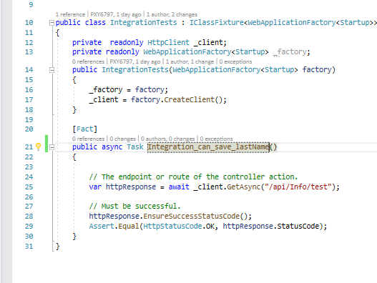
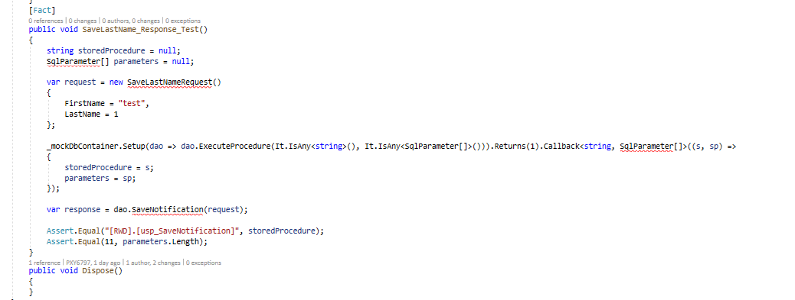
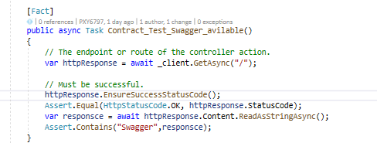
Unit, Integration, Component & Contract Test

Slide 12
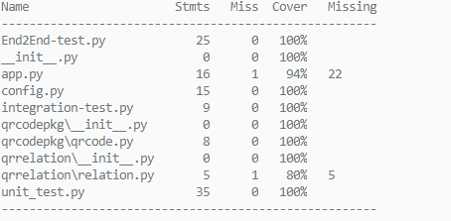
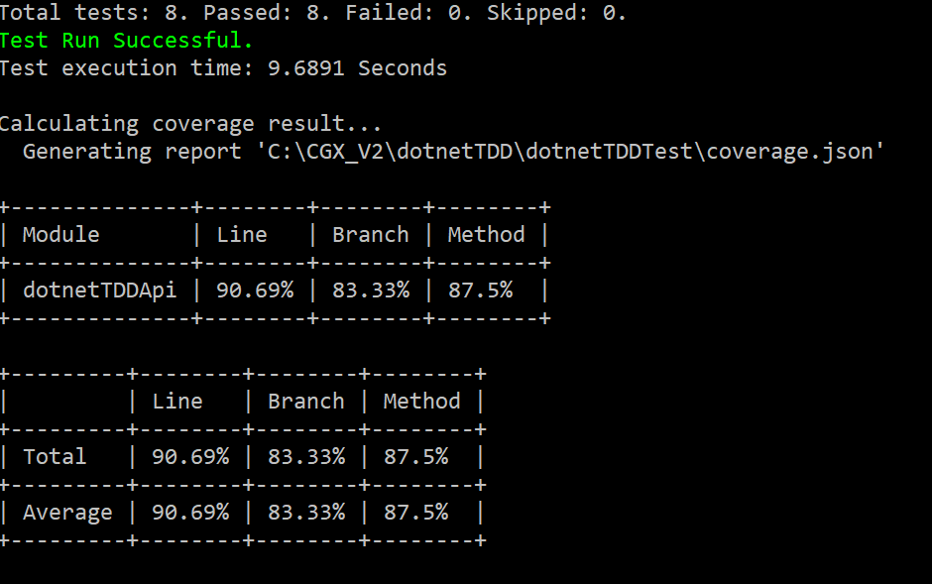
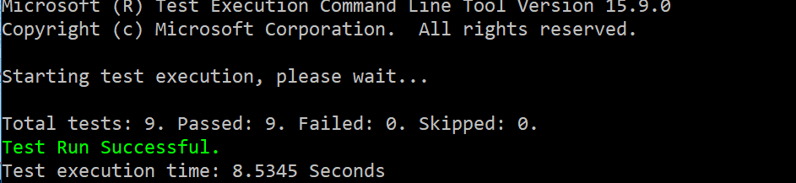
Coverage and Gates

Slide 13
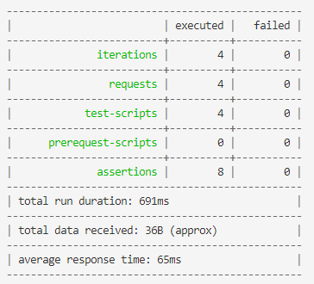
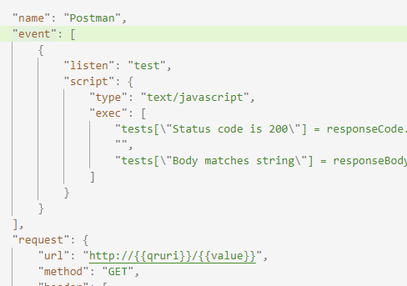
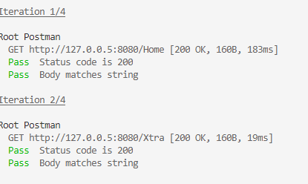
Postman/jmeter
parallelCollectionRun = function (done) {
newman.run(options, done);
};
// Runs the Postman sample collection thrice, in parallel.
async.parallel([
parallelCollectionRun,
parallelCollectionRun,
parallelCollectionRun,
parallelCollectionRun,
parallelCollectionRun,
parallelCollectionRun,
parallelCollectionRun,
parallelCollectionRun,
parallelCollectionRun,
parallelCollectionRun,
],
Cmd : Node parallelrun.js

Slide 14
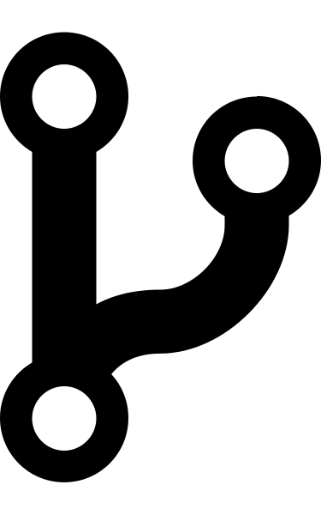
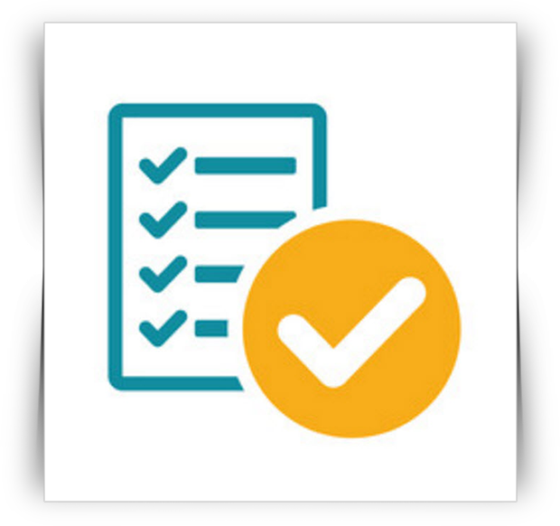
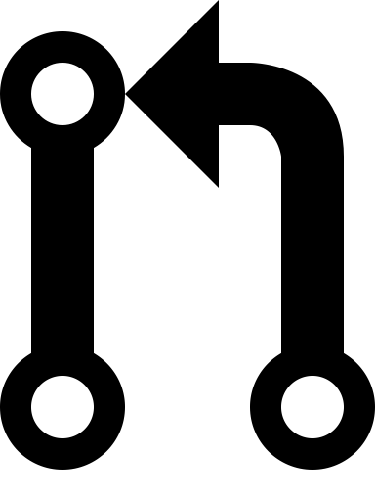

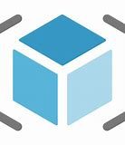
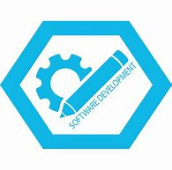

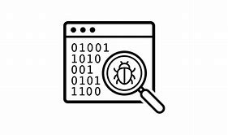

End to End
Functional Test
Unit Test
Fail
Refactor
Pass
Pass
Inside
(TDD)
Fail
Outside
(ATDD)
Fail
Refactor
Notes:
Test code is as important as production code. Give it the same level of care and attention. "this is only test code" is not a valid excuse to justify sloppy code
Test one condition per test. This helps you to keep your tests short and easy to reason about
"arrange, act, assert" or "given, when, then" are good mnemonics to keep your tests well-structured
Readability matters. Don't try to be overly DRY . Duplication is okay, if it improves readability. Try to find a balance between DRY and DAMP code
When in doubt use the Rule of Three to decide when to refactor. Use before reuse

Slide 15
Q & A ?
More about tests / microservices / stuff https://martinfowler.com/articles/microservice-testing
https://www.hindsightsoftware.com/blog/tdd-vs-bdd
http://12factor.net/
http://www.appcontinuum.io/
https://xbehave.github.io/
https://github.com/jkcpavan/TDDPython
https://github.com/jkcpavan/dotnetcoreTDD

Slide 16
Thank You
2018.Yadlapalli@gmail.com
https://www.linkedin.com/in/pavankumar-yadlapalli-4035b369/

